Slide 1
Innovative Monitoring System for TeleICU Patient Using Video Processing & Deep Learning
By, Jaimin Maniyar Ranjita Nair

Slide 2
Objective
Objective
Intention behind creating this project is to do some advancement with existing TeleICU system.
TeleICU system is a system in which Intensivist monitors the ICU patients from remote location. It is made for overcome shortage of Intensivist & ICU Nurse.
To reduce the monitoring task overload, we need some kind of system which can do basic as well as advance work of monitoring by itself.
We are proposing the "Innovative Monitoring System for TeleICU Patients" which is capable of monitoring the critical care patient & make collaboration with the person at control center of TeleICU.
Intension behind developing such system is to avoid human errors and fulfil all type of requests by critical care patients with small number of medical staff.

Slide 3
Challenges
Data collection & pre-processing of data for supervised learning approach
After creation of labelled data, the challenge was detection of patient from the frame. Detection is difficult because so many types of person available in the frame.
For motion detection in scene the challenge is so many moving objects available in the frame e.g. ECG machine. The motion done by these machines is also captured by algorithm so, only patient movements detection is difficult
Coordination between the existing TeleICU system and our System
High Accuracy & Timing of prediction needs more focus.

Slide 4
Related Work
F-RCNN
YoloNet
Various Motion Detection System
ICU Care System

Slide 5
Typical TeleICU System

Slide 6
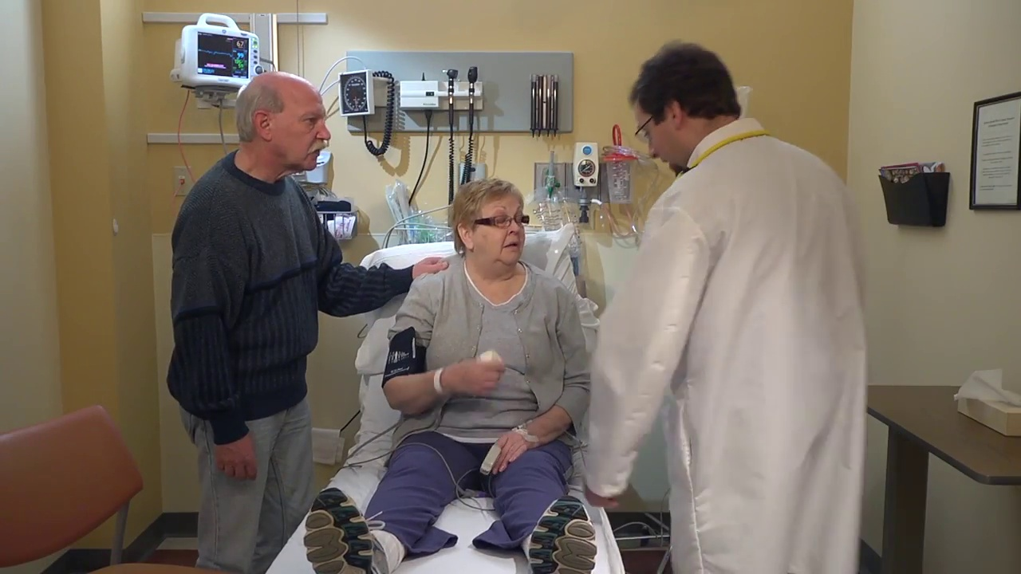
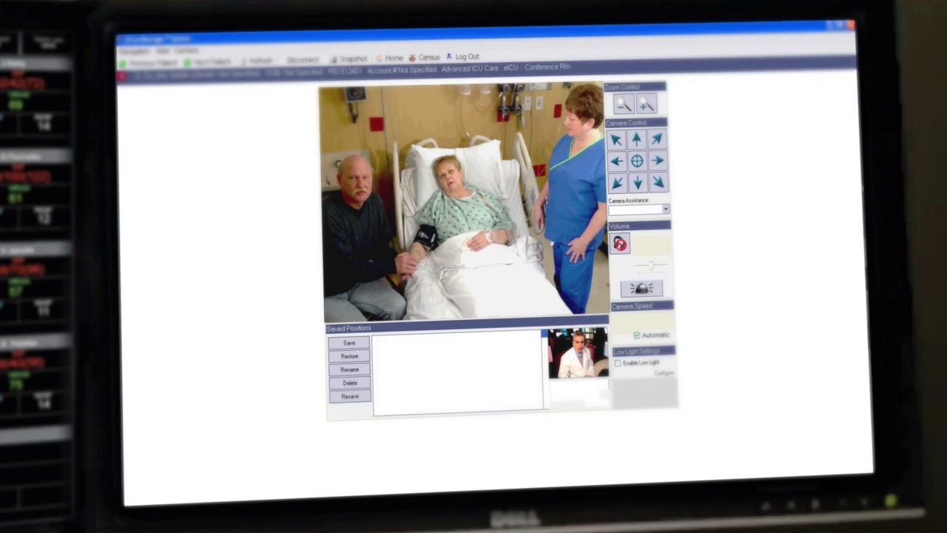
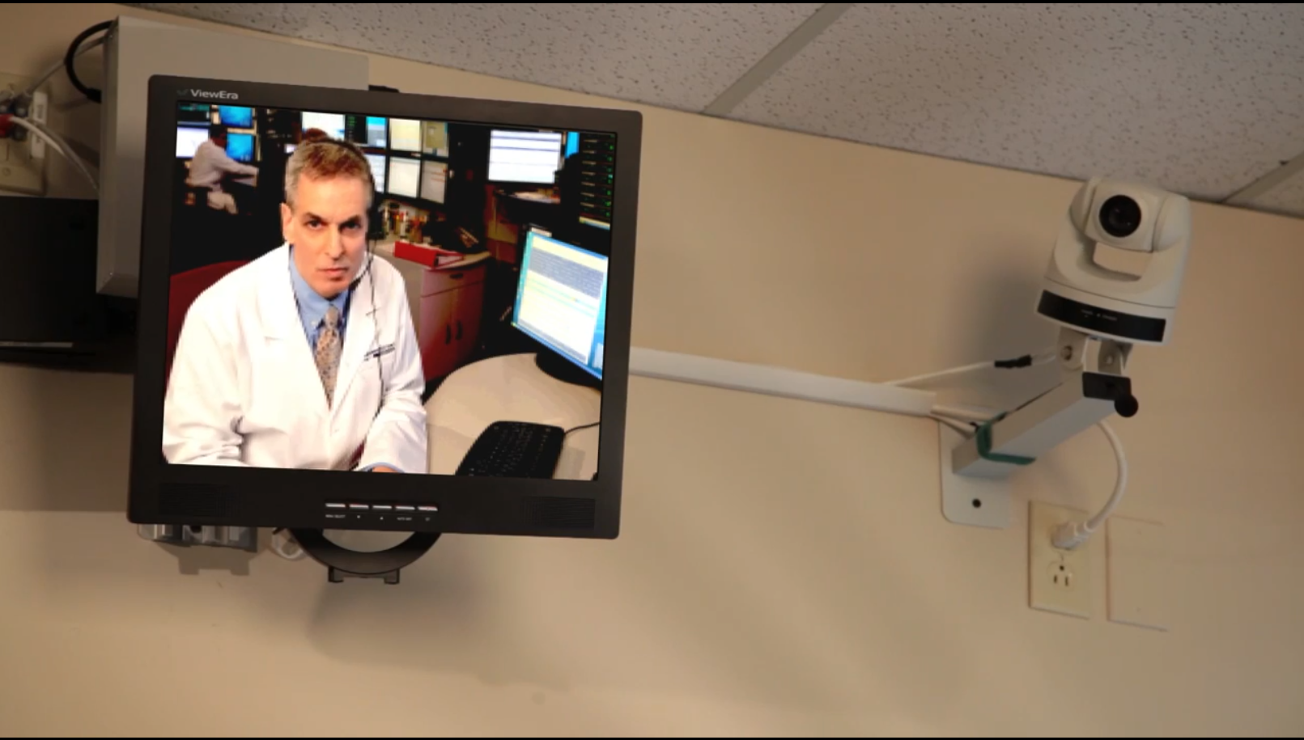
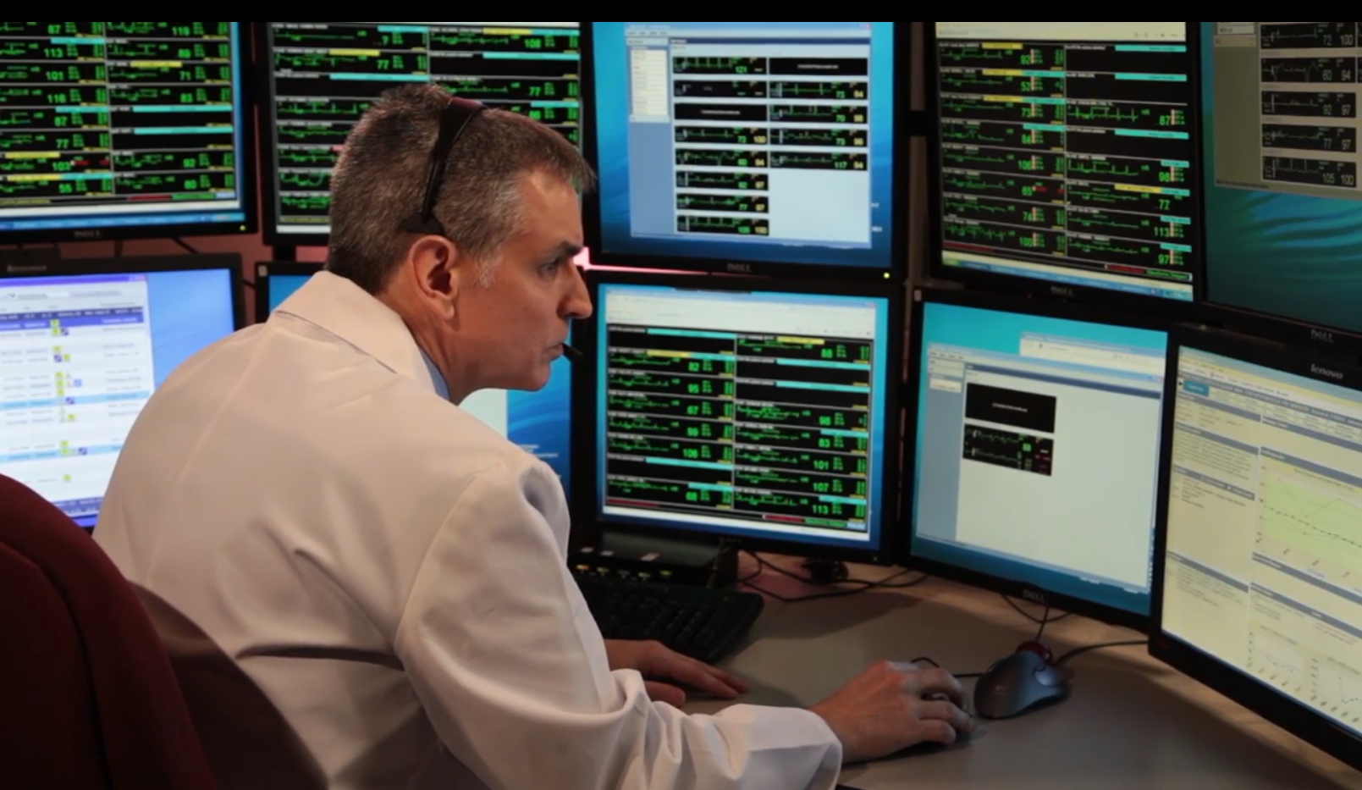

Slide 7
System Component
Server Processing Unit
Web View Handler
ICU ROOM
Control Center
Processing & Collection of data
Stream Handler

Slide 8
Dataset Generation
Collection of video data from various YouTube videos
Cleaning of Unwanted frames
Label Generation for supervised learning
Separation of test & train
Storing for model generation & reusing

Slide 9
The working of system is divided mainly into 3 parts:
1) Person Type Detection 2) Motion Detection & 3) Event Handlers
Person Type Detection
This module is starting point of the system. It will detect & count the type of person present in the ICU room. Here, we are using deep learning network to train the model for prediction & counting number of person. Now based on person present in the room priority of generating alarm & system continuity will differ.
Motion Detection
With the help of this module we are detecting any type of motion happens in the ICU room. Here, some unusual motions are also detected so we put a ROI to detect the motion of patient. After motion is detected, we put a threshold of 3 second to generate notification of what type of motion is occurred. For motion type detection we will deep learning.
Event Handlers
This module is made for handling various type of events happens in the system. e.g. when patient is in some problem notification & alert is generated and displayed at control center etc.
How it Works?

Slide 10
Architecture of System
Input
Server Processing Unit
Pre-processing of frames
Person Type Detection
ROI Setting
Stream of Video
Motion Detection
Action Handler
Web Notification
Storing Data
Event Triggered
Control Center

Slide 11
Result MAP Value 89.77

Slide 12
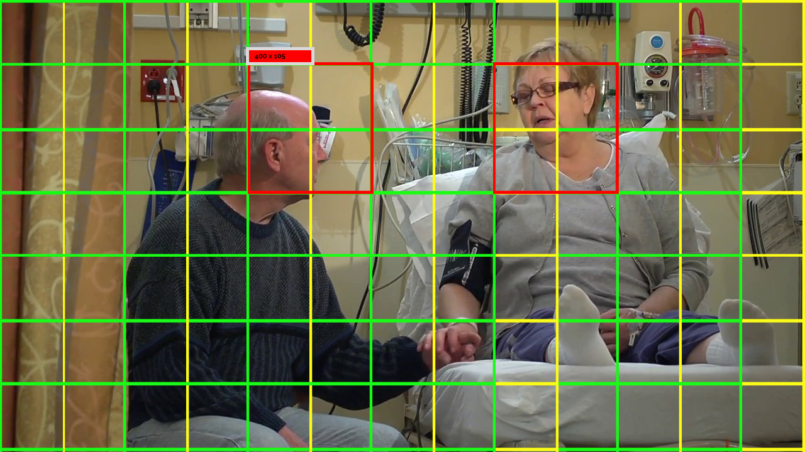

Slide 13
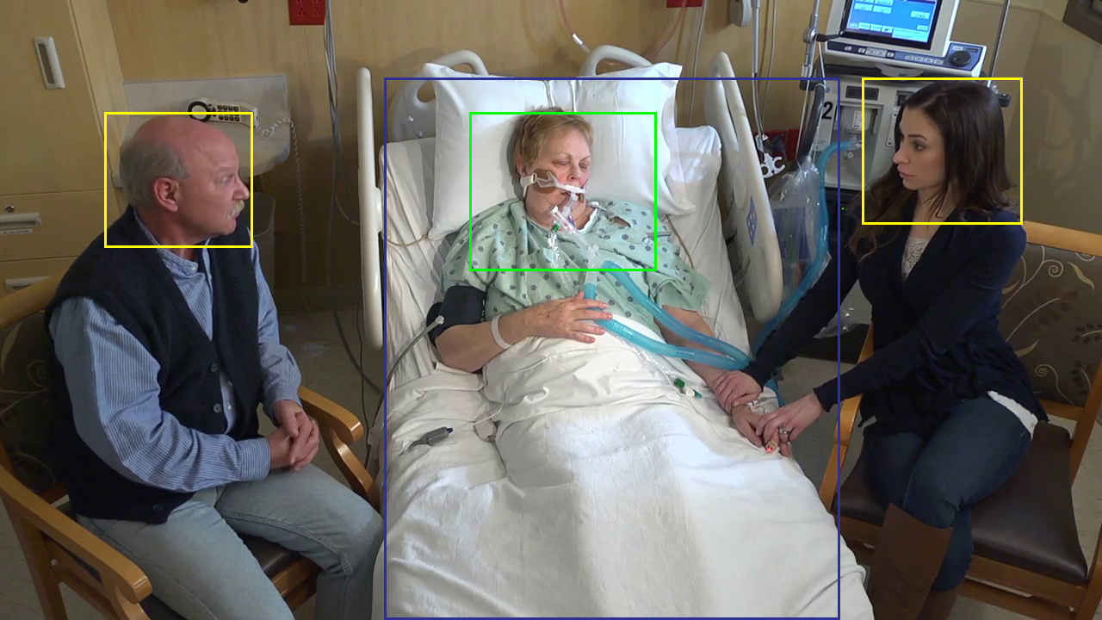

Slide 14
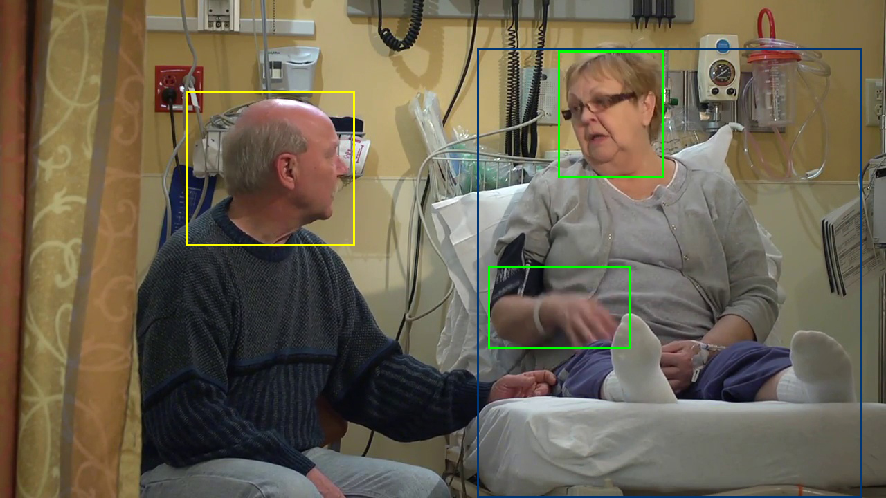

Slide 15
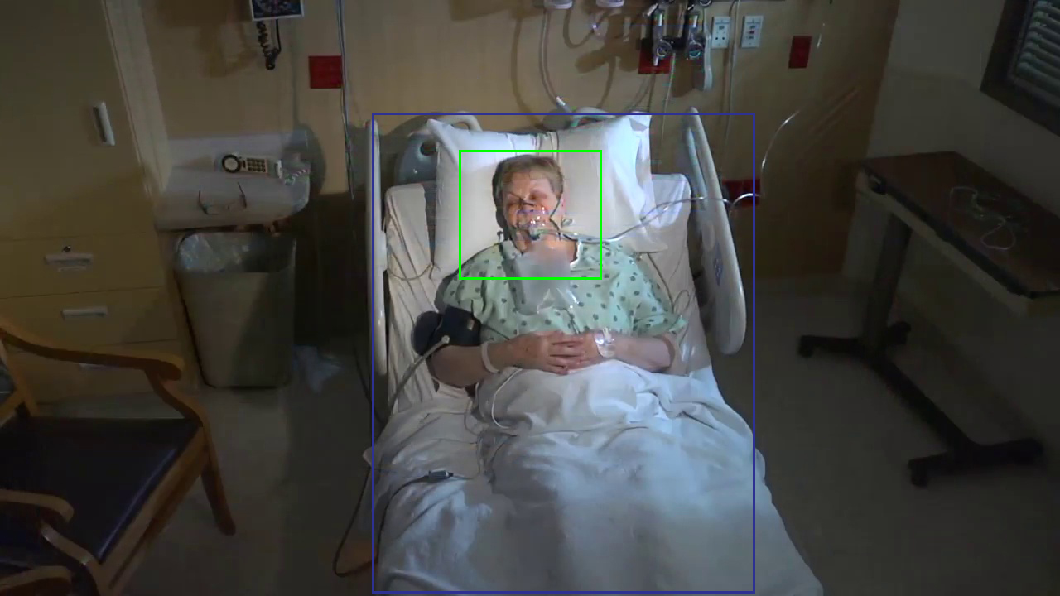

Slide 16
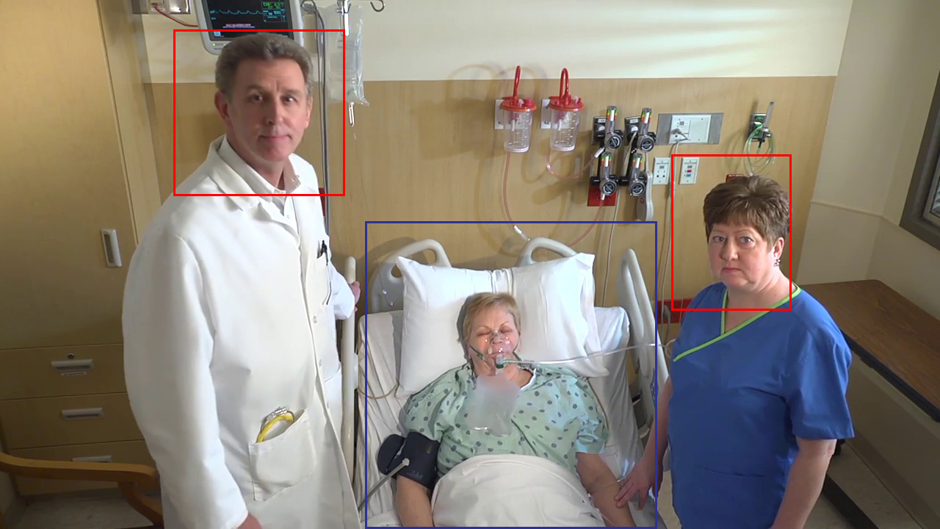

Slide 17
Conclusion
The project is detecting the type of person and motion of person and integrating it to the event handler which will notify on the screen of control center. The project will be expanded to the type of motions that patient will be making and segregating according to the motions and alarming intensivist according to the severity.

Slide 18
References
[1] Ren, S., He, K., Girshick, R., & Sun, J. (2015). Faster r-cnn: Towards real-time object detection with region proposal networks. In Advances in neural information processing systems (pp. 91-99).
[2] Redmon, J., & Farhadi, A. (2016). YOLO9000: Better, Faster, Stronger. arXiv preprint arXiv:1612.08242.
[3] Kumar, S., Merchant, S., & Reynolds, R. (2013). Tele-ICU: efﬁcacy and cost-effectiveness approach of remotely managing the critical care. The open medical informatics journal, 7, 24.
[4] Chihaoui, M., Elkeﬁ, A., Bellil, W., & Amar, C. B. (2016). Detection and tracking of the moving objects in a video sequence by geodesic active contour. In Computer Graphics, Imaging and Visualization (CGiV), 2016 13th International Conference on (pp. 212-215).
[5] Rajput, S. J., & Oza, S. D. (2013)A New Algorithm for Tracking of Multiple Moving Objects. international Journal of Scientiﬁc Engineering and Technology, Volume, (2), 691-693.
[6] Raheja, J. L., Gopinath, D., & Chaudhary, A. (2014). GUI system for elders/patients in intensive care. In Technology Management Conference (ITMC), 2014 IEEE International (pp. 1-5).

Slide 19
Thank You

